Slide 1


Slide 2



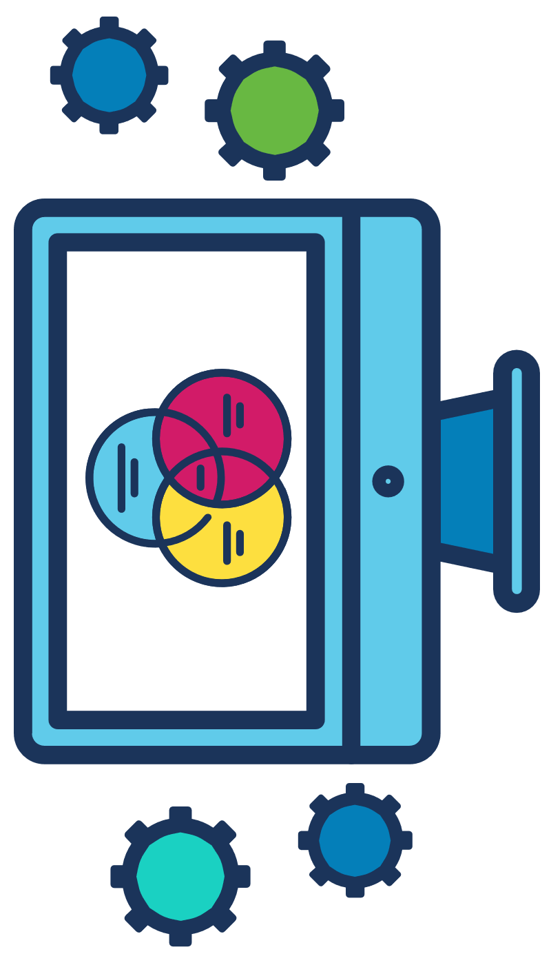
PRESENTATION TOPIC -
How do search engines work ? How it suggests us the most relevant topics we try to find out.
“ Web Mining & Data Mining ”
PRESENTATION COURSE :
BU_CSE_EDGE
COURSE TITLE :
Computer Fundamentals and Office Applications (CFOA)
COURSE TEACHER -
Topic & Course
WEB MINING
MD. Rahat Hossain Faisal
Associate Professor
DEPARTMENT OF COMPUTER SCIENCE AND ENGINEERING
UNIVERSITY OF BARISHAL

Slide 3


Presenter
BAHAUDDIN BAHAR
ROLL : 004
SESSION : BATCH-35
EDGE: BU_CSE_SKILLS TRAINING
UNIVERSITY OF BARISHAL

Slide 4
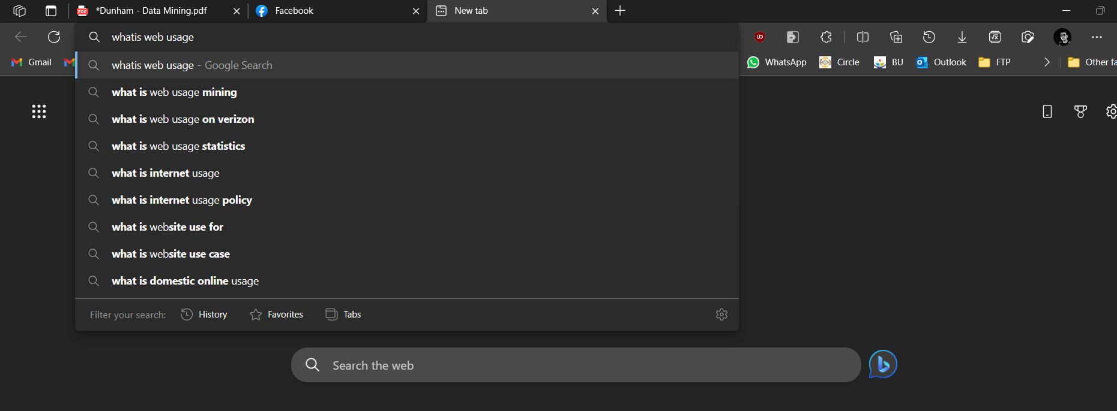
How do search engines work ? How it suggests us the most relevant topics we try to find out
WEB MINING

Slide 5
Web Usage Mining
Web Usage Mining:
Web usage mining is the application of identifying or discovering interesting usage patterns from large data sets. And these patterns enable you to understand the user behaviors or something like that. In web usage mining, user access data on the web and collect data in form of logs. So, Web usage mining is also called log mining.
Web usage mining applications has included:
1.Personalization for a user can be achieved by keeping track of previously accessed pages. These pages can be used to identify the typical browsing behavior of a user and subsequently to predict desired pages.
2. By determining frequent access behavior for users, needed links can be identified to improve the overall performance of future accesses. 3. Information concerning frequently accessed pages can be used for caching 4. Web usage patterns can be used to gather business intelligence to improve sales and advertisement.
WEB MINING
Preprocessing:
The Web usage log probably is not in a format that is usable by mining applications. As With any data to be used in a mining application, the data may need to be reformatted and cleansed. There are, in addition, some issues specifically related to the use of web logs. Steps that are part of the preprocessing phase include cleansing, user identification, session identification, path completion, and formatting.

Slide 6
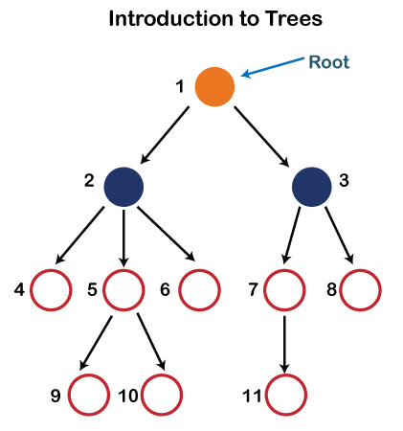
Data Structures:
There are several unique data structures have been proposed to keep track of patterns identified during the web usage mining process. A basic data structure that is used is called a tree. A tree is a rooted tree, where each path from the root to a leaf represents a sequence. Trees can save strings for pattern-matching applications. The only problem with trees is space requirements.
WEB MINING

Slide 7

Pattern Discovery :
Web usage mining is the application of data mining techniques to discover usage patterns from Web data, in order to understand and better serve the needs of Web-based applications. Web usage mining consists of three phases, namely preprocessing, pattern discovery, and pattern analysis.
Association Rules :
Association rules can be used to find what pages are accessed together.
WEB MINING

Slide 8
Web Mining
Web Content Mining
Web Structure Mining
Web Usage Mining
Image
Text
Web server Logs
Application server logs
Audio
Video
List/Tab/Record
Hyperlinks
Documents
Application level logs

Slide 9
THANK YOU SO MUCH FOR WATCHING
Now, if you have any questions about this presentation you can ask.

